Slide 1
Simulation of Potential Mobility of Contaminant Plumes
Prepared for
Sacramento Central Groundwater Authority
July 13, 2011

Slide 2
Project Objective
Use the SacIWRM Particle Tracking Module (PTM) to simulate the temporal and spatial movement of regional contamination plumes for a 105-year hydrologic period
Regional contamination plumes simulated:
Aerojet
Boeing
McClellan
Mather
Sacramento Downtown Railyard

Slide 3
Project Approach
Collect data & update the SacIWRM model as needed
Use PTM to track particles, conservatively representing contamination plumes

Slide 4
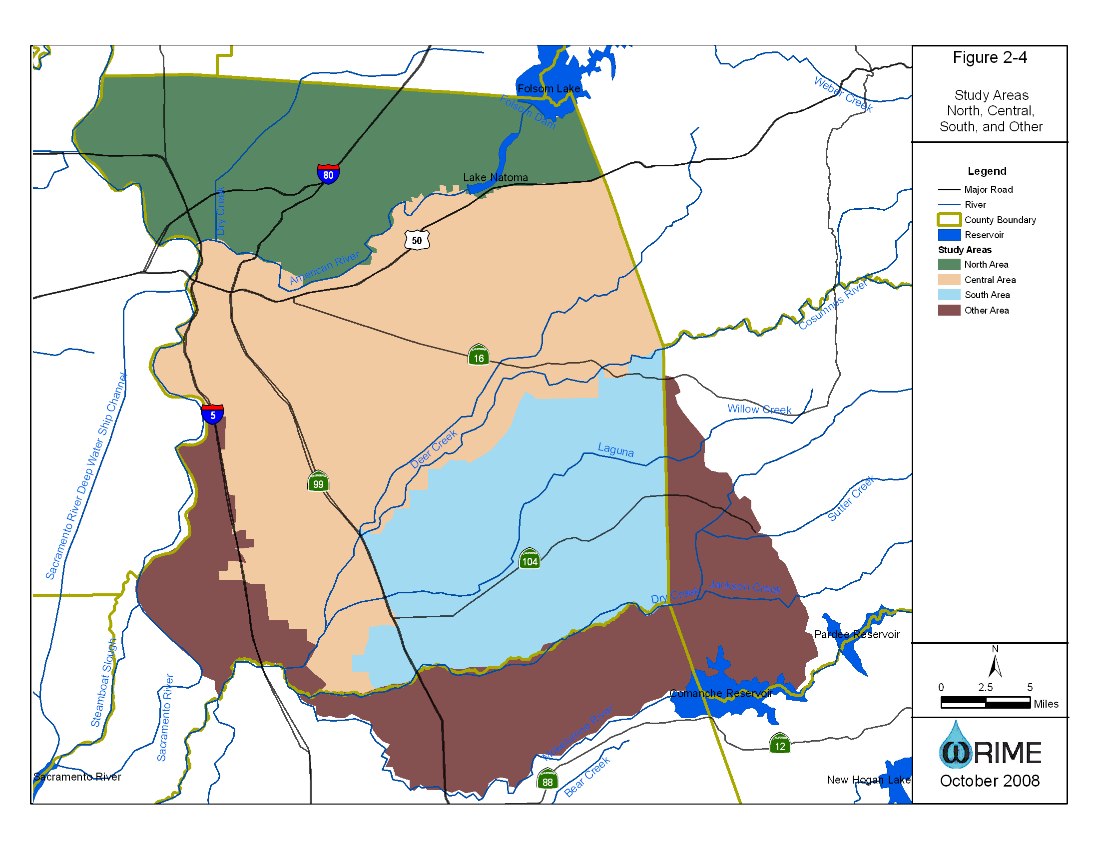

Slide 5
Recent History of SacIGSM Baseline Model Development
North Area refinement, re-calibration, and baseline update in September 2007 (SGA)
Central Area and South Area refinement & re-calibration in June 2008 (TNC)
Central Area baseline update in January 2009 (SCGA)
South Area baseline update in April 2009 (RBI)
Update of Remediation Operations June 2010 (SGA & SCGA)

Slide 6
Baseline Model Assumptions Land Use
Land use based on DWR Land Use Survey 2000 Sacramento County.
Non-urban parcels converted to urban between 2000 and 2007 were urbanized for the model based on Sacramento County APN data.

Slide 7
Water Use
Incorporates
Groundwater
Surface water
Tailwater reuse
Recycled water
Agricultural
Crop type and soil/climate data – Model calculations
Municipal
UWMP data and local data
Calibrated assumptions for rural areas

Slide 8
Remediation Operations Update
SacIWRM was updated with data on planned future remediation operations for Aerojet, Boeing, and Mather
Operations of McClellan reflected current level of remediation
No remediation operations at the Railyard site

Slide 9
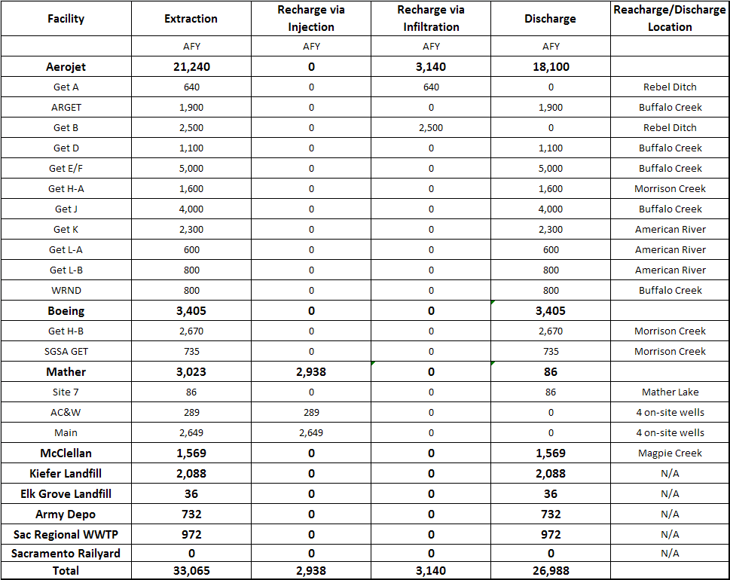
Remediation Operations Simulated in SacIWRM

Slide 10
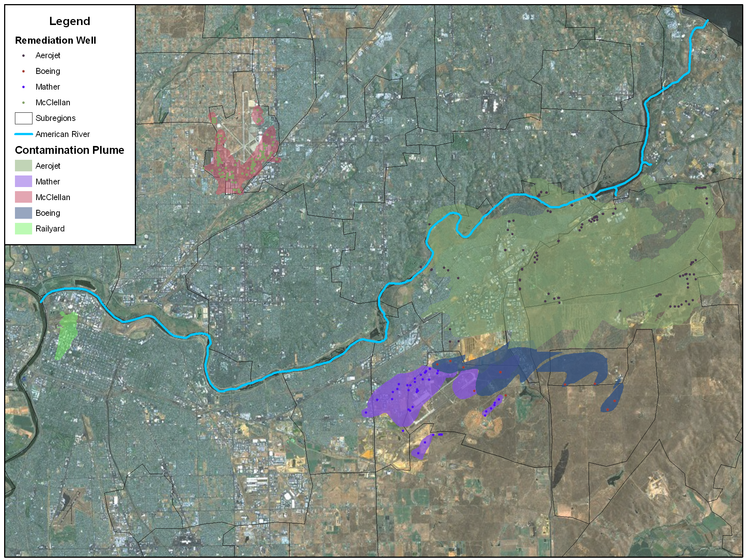
Regional Contamination Plumes (Based on 2007 Data)

Slide 11
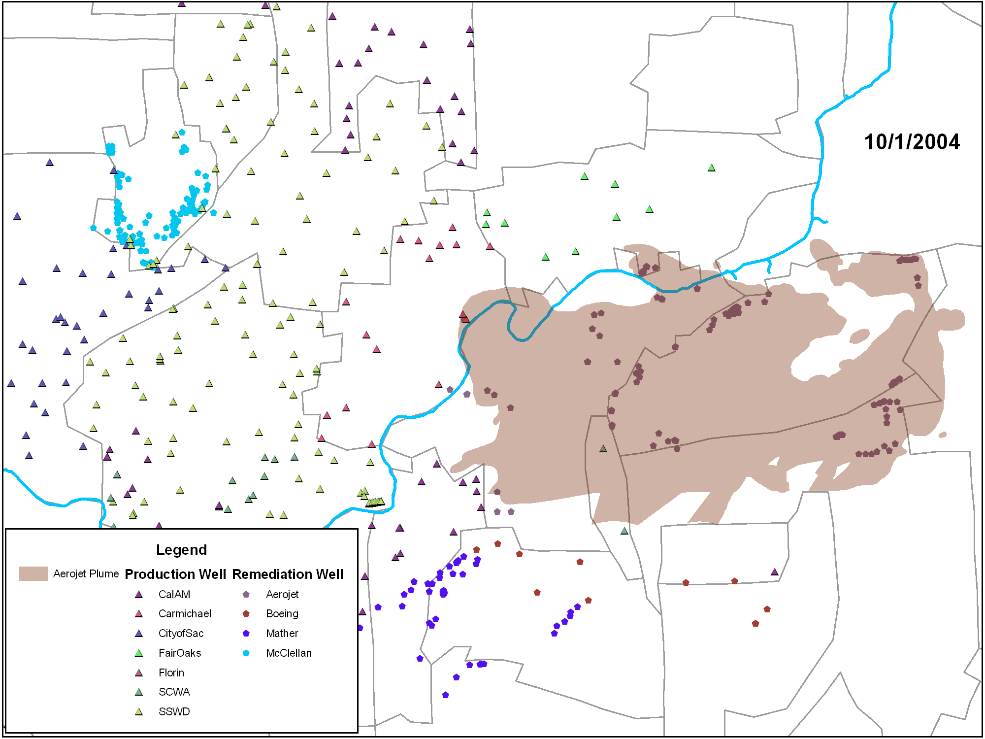

Slide 12
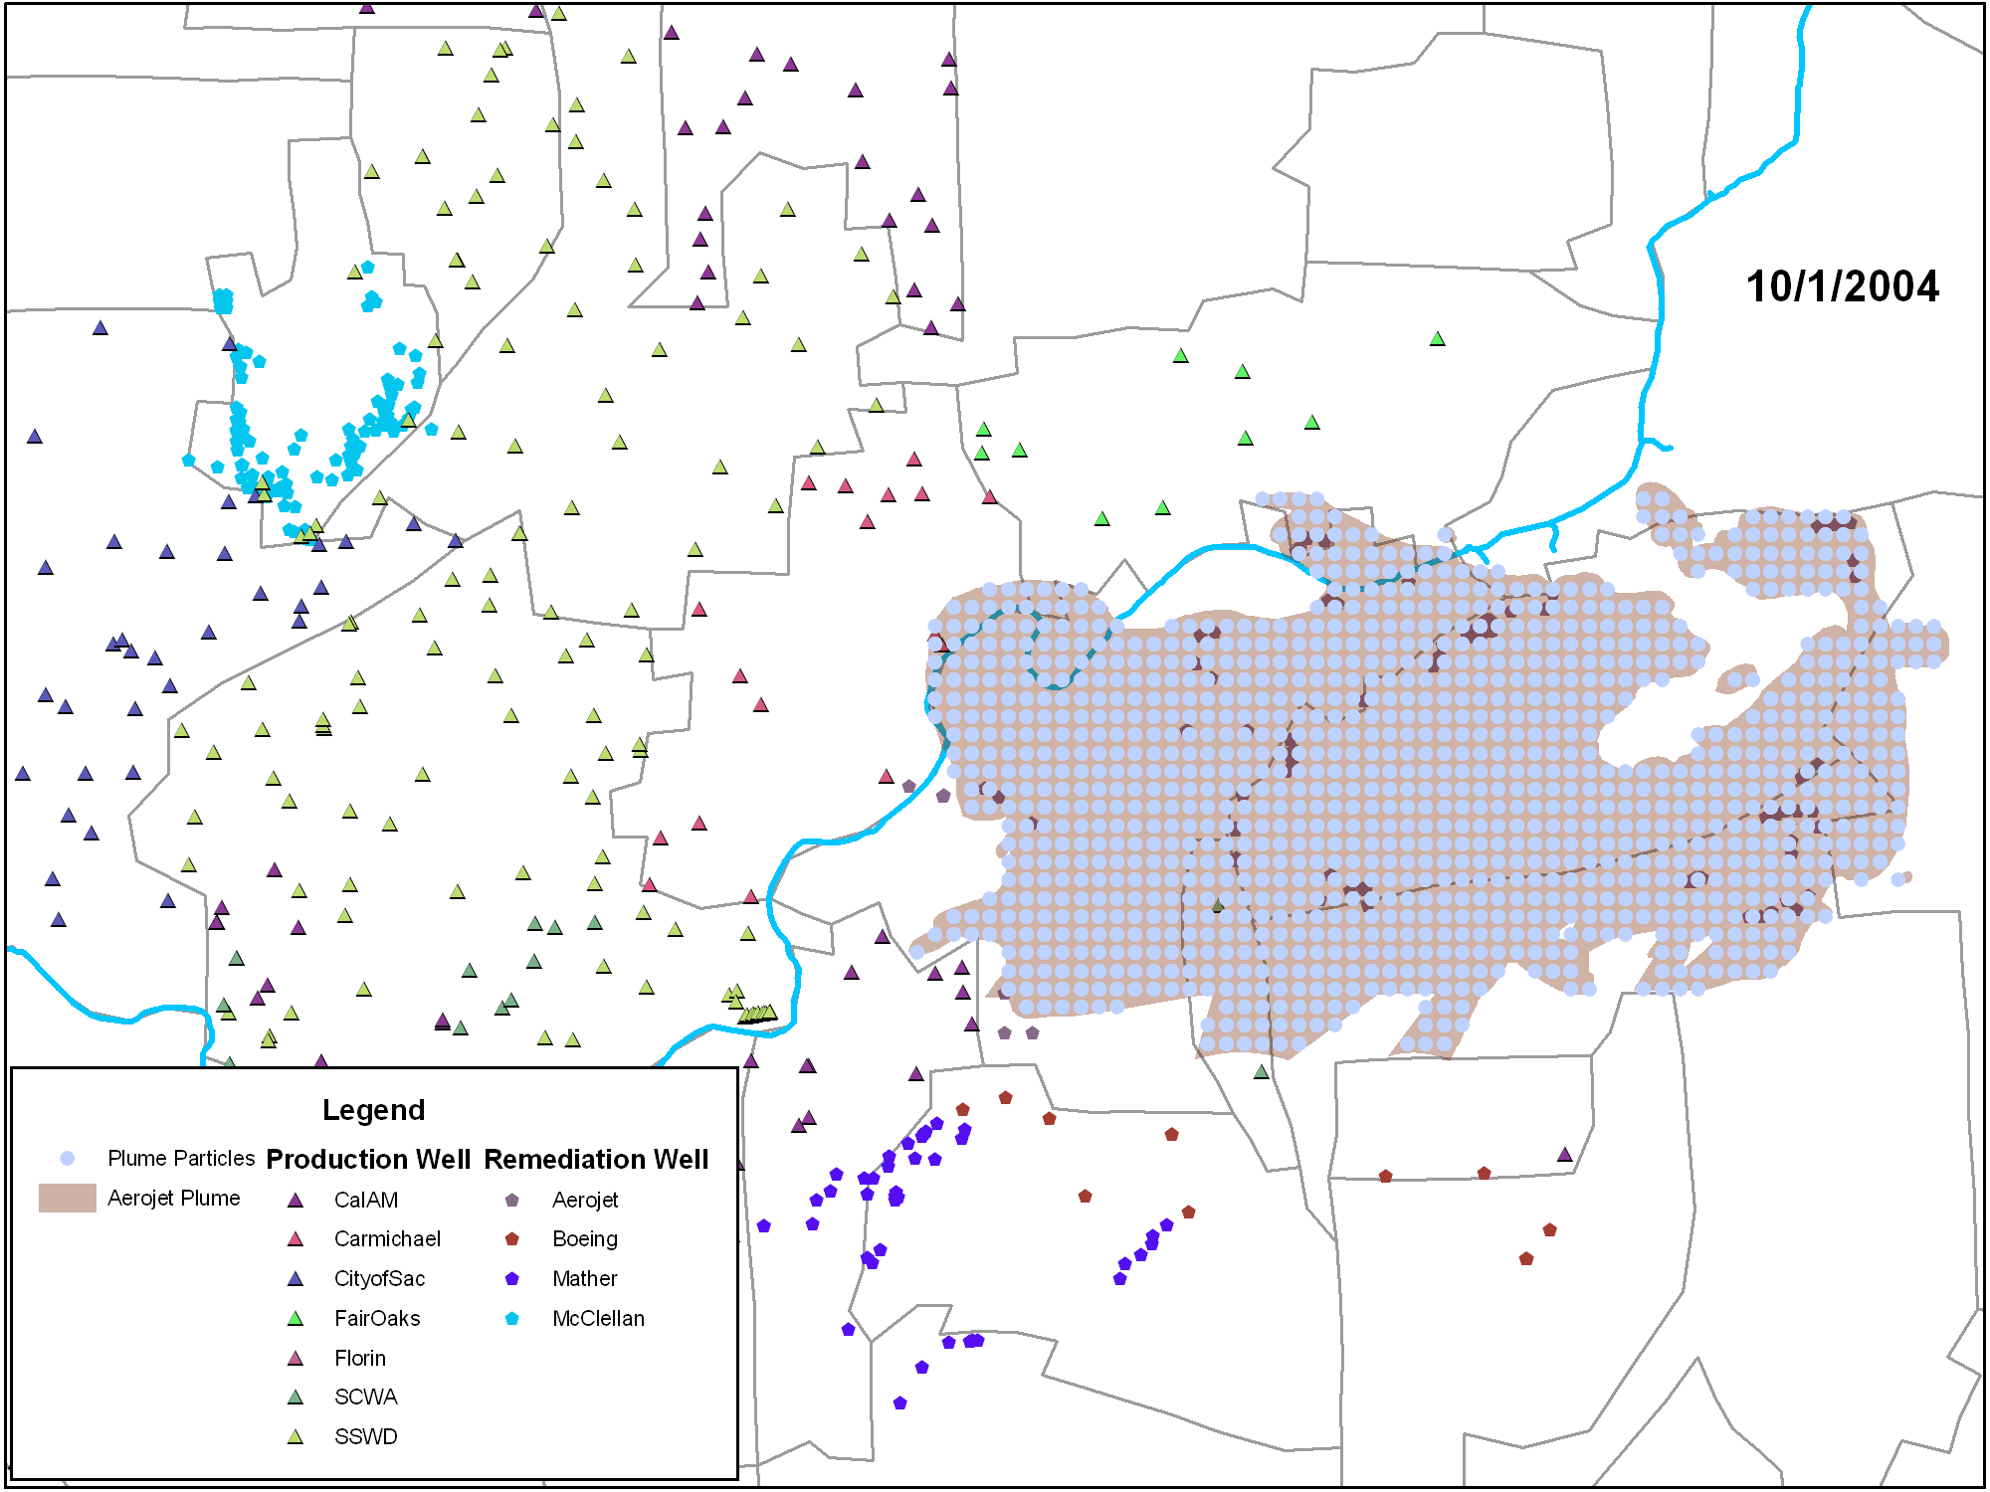

Slide 13
Animation of Baseline Results

Slide 14
Summary
10 Years
No Aerojet or Boeing particles representing the plume have escaped into the SCGA production wells influence area
1% of Mather particles representing the plume have escaped into the SCGA production wells influence area
105 Years
1% of Aerojet particles representing the plume have escaped into the SCGA production wells influence area
8% of Boeing particles representing the plume have escaped into the SCGA production wells influence area
19% of Mather particles representing the plume have escaped into the SCGA production wells influence area

Slide 15
Relation to Mather Cleanup Work
Presentation given by AFRPA - May Board meeting
Differences due to scale (space and time)
SacIWRM – includes impacts of regional groundwater system
Mather –
Model includes more detailed, local lithology
Detailed concentration data
Monitoring activities lead decision making
Monitoring allows for ongoing optimization of cleanup

Slide 16
Needed Coordination
Development activities
New supply wells
Preservation of monitoring network
Modeling
Regional conditions → Local model boundaries
Remediation pumping → Regional model
Cleanup progress updates
Element of GWMP: Control of the Migration and Remediation of Contaminated Groundwater

Slide 17
Questions

