Slide 1
American River Basin Integrated Regional Water Management Plan Update Process SCGA Board Meeting
July 13, 2011

Slide 2
Overview
State IRWM Program Objectives
Overview of Existing IRWMP
Current Improvements and Updates to IRWMP

Slide 3
The State’s IRWM Program Objectives
Improve water supply reliability
Protect & improve water quality
Ensure sustainability through environmental stewardship
Promote multiple benefits from project investments
Promote integration and regional planning through financial incentives
“In broad strokes, sustainable, integrated resources management means considering water supply reliability, flood management, water quality, and ecosystem protection and restoration in all resource management decisions.” Mark Cowin, DWR Director, February 2, 2010

Slide 4
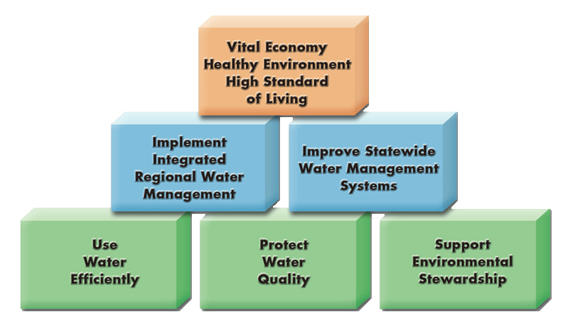
California Water Plan

Slide 5
Highlights of Existing ARB IRWMP
Initial IRWM adopted May 2006
“Living document” to be updated in future
Projects prioritized based on State guidelines
Included over 180 projects/programs
At least 30 different groups with projects identified
Not a funding mechanism specifically, but a vehicle for stakeholders to pursue funding opportunities or partnerships as a group or on their own

Slide 6
IRWM Relation to Other Plans
Not meant to supplant need for, or authority for, other planning
Not meant to fully capture all aspects of other planning efforts
Needs other plan developers to provide information as to what is relevant to include in the IRWMP
Should begin to drive more integrated thinking as other plans are developed in future

Slide 7
Current Improvements & Updates
Modified boundary
Upper/lower basin coordination
Incorporate Prop 84 requirements:
Region Acceptance Process (completed)
New governance structure (completed)
Goals and objectives with metrics
Consider needs of disadvantaged communities
Climate change
Additional stakeholder outreach

Slide 8
ARB and CABY IRWMP Boundaries
Memorandum of Understanding signed 2009

Slide 9
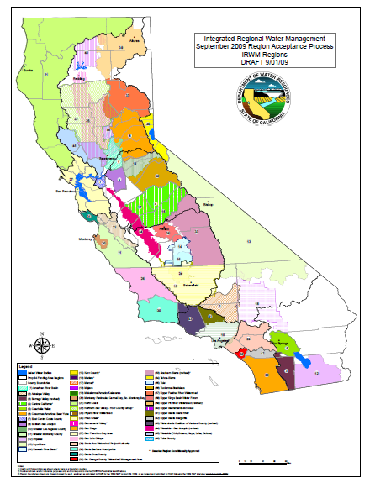
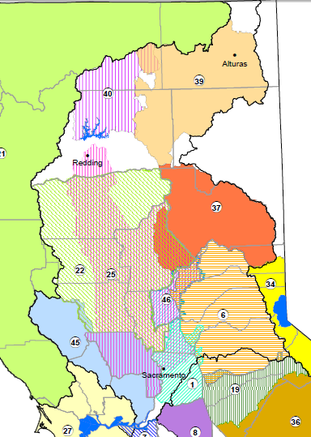
Region Acceptance Process
46 IRWM Regions Statewide
Sac River Region has
Seven approved regions
Two conditionally approved regions

Slide 10
Governance
Structure

Slide 11
Additional Outreach
3 planning/stakeholder forums
Over 150 people on distribution list
8 work group meetings on topics:
Stormwater quality
Watershed management
Climate change
Water supply/demand management
Agriculture
Flood/floodplain management

Slide 12
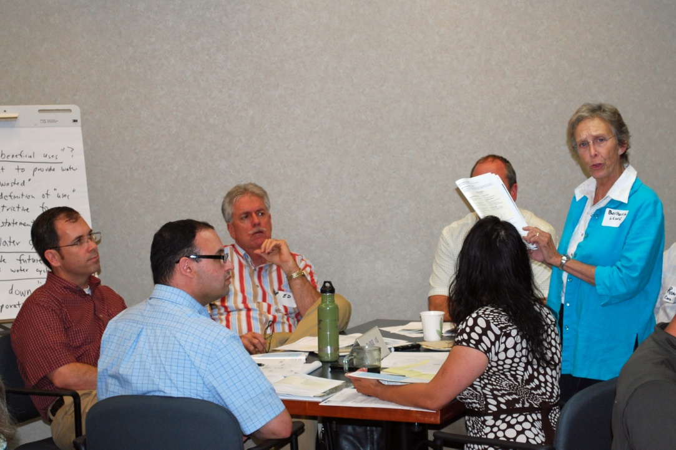
Additional Outreach (continued)
IRWM Update Workshop
39 participants
Input on:
Vision
Principles
Goals

Slide 13
Draft Vision and Goals
Vision
Water resources for all uses in a sustainable environment
Goals
Provide a reliable and sustainable water supply, sufficient to meet the existing and future needs of the region
Protect and enhance the quality of surface water and groundwater
Protect and enhance the environmental resources of the watersheds within the region
Protect the people, property, and environmental resources of the region from damaging flooding

Slide 14
IRWMP Primary Tasks
Jan 2011
Jan 2012
Jan 2013
Basic Data
DAC Involvement
Climate
Goals/Objectives
Web Interface
Projects
Prioritization
Prepare Plan

Slide 15
Additional Information
ARB IRWMP available on-line at: www.rwah2o.org/rwa/programs/irwmp/
or
Contact Rob Swartz (RWA) at:
rswartz@rwah2o.org
(916) 967-7692

